Slide 1
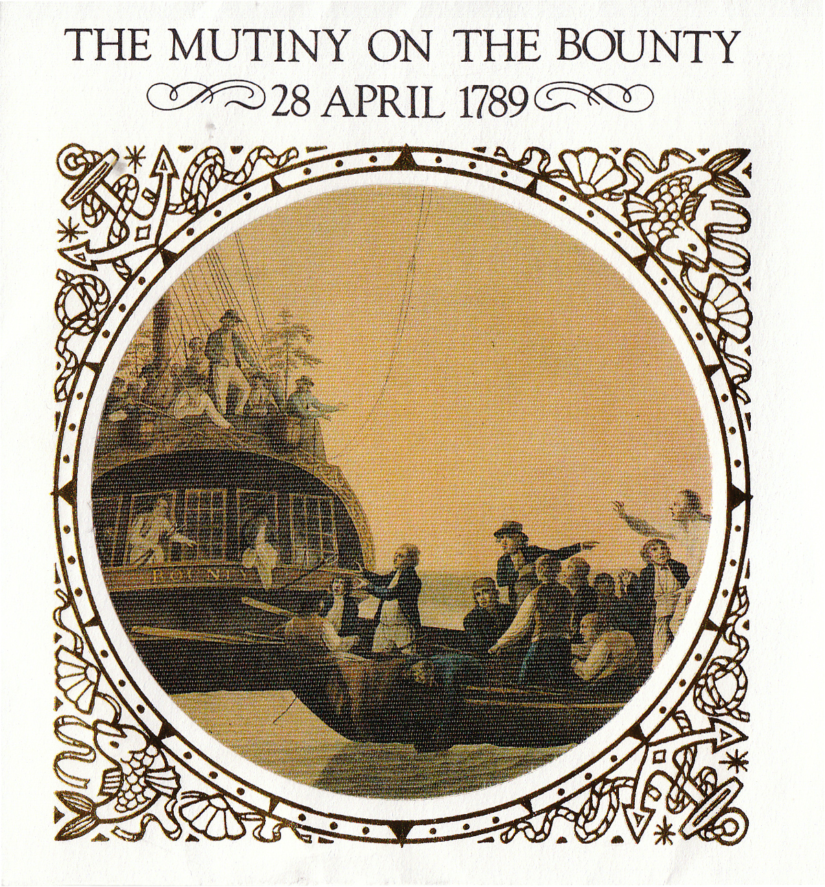
‘Mutiny’ in the Magazine Section:
Bounty, Pitcairn and the Popular Press

Slide 2
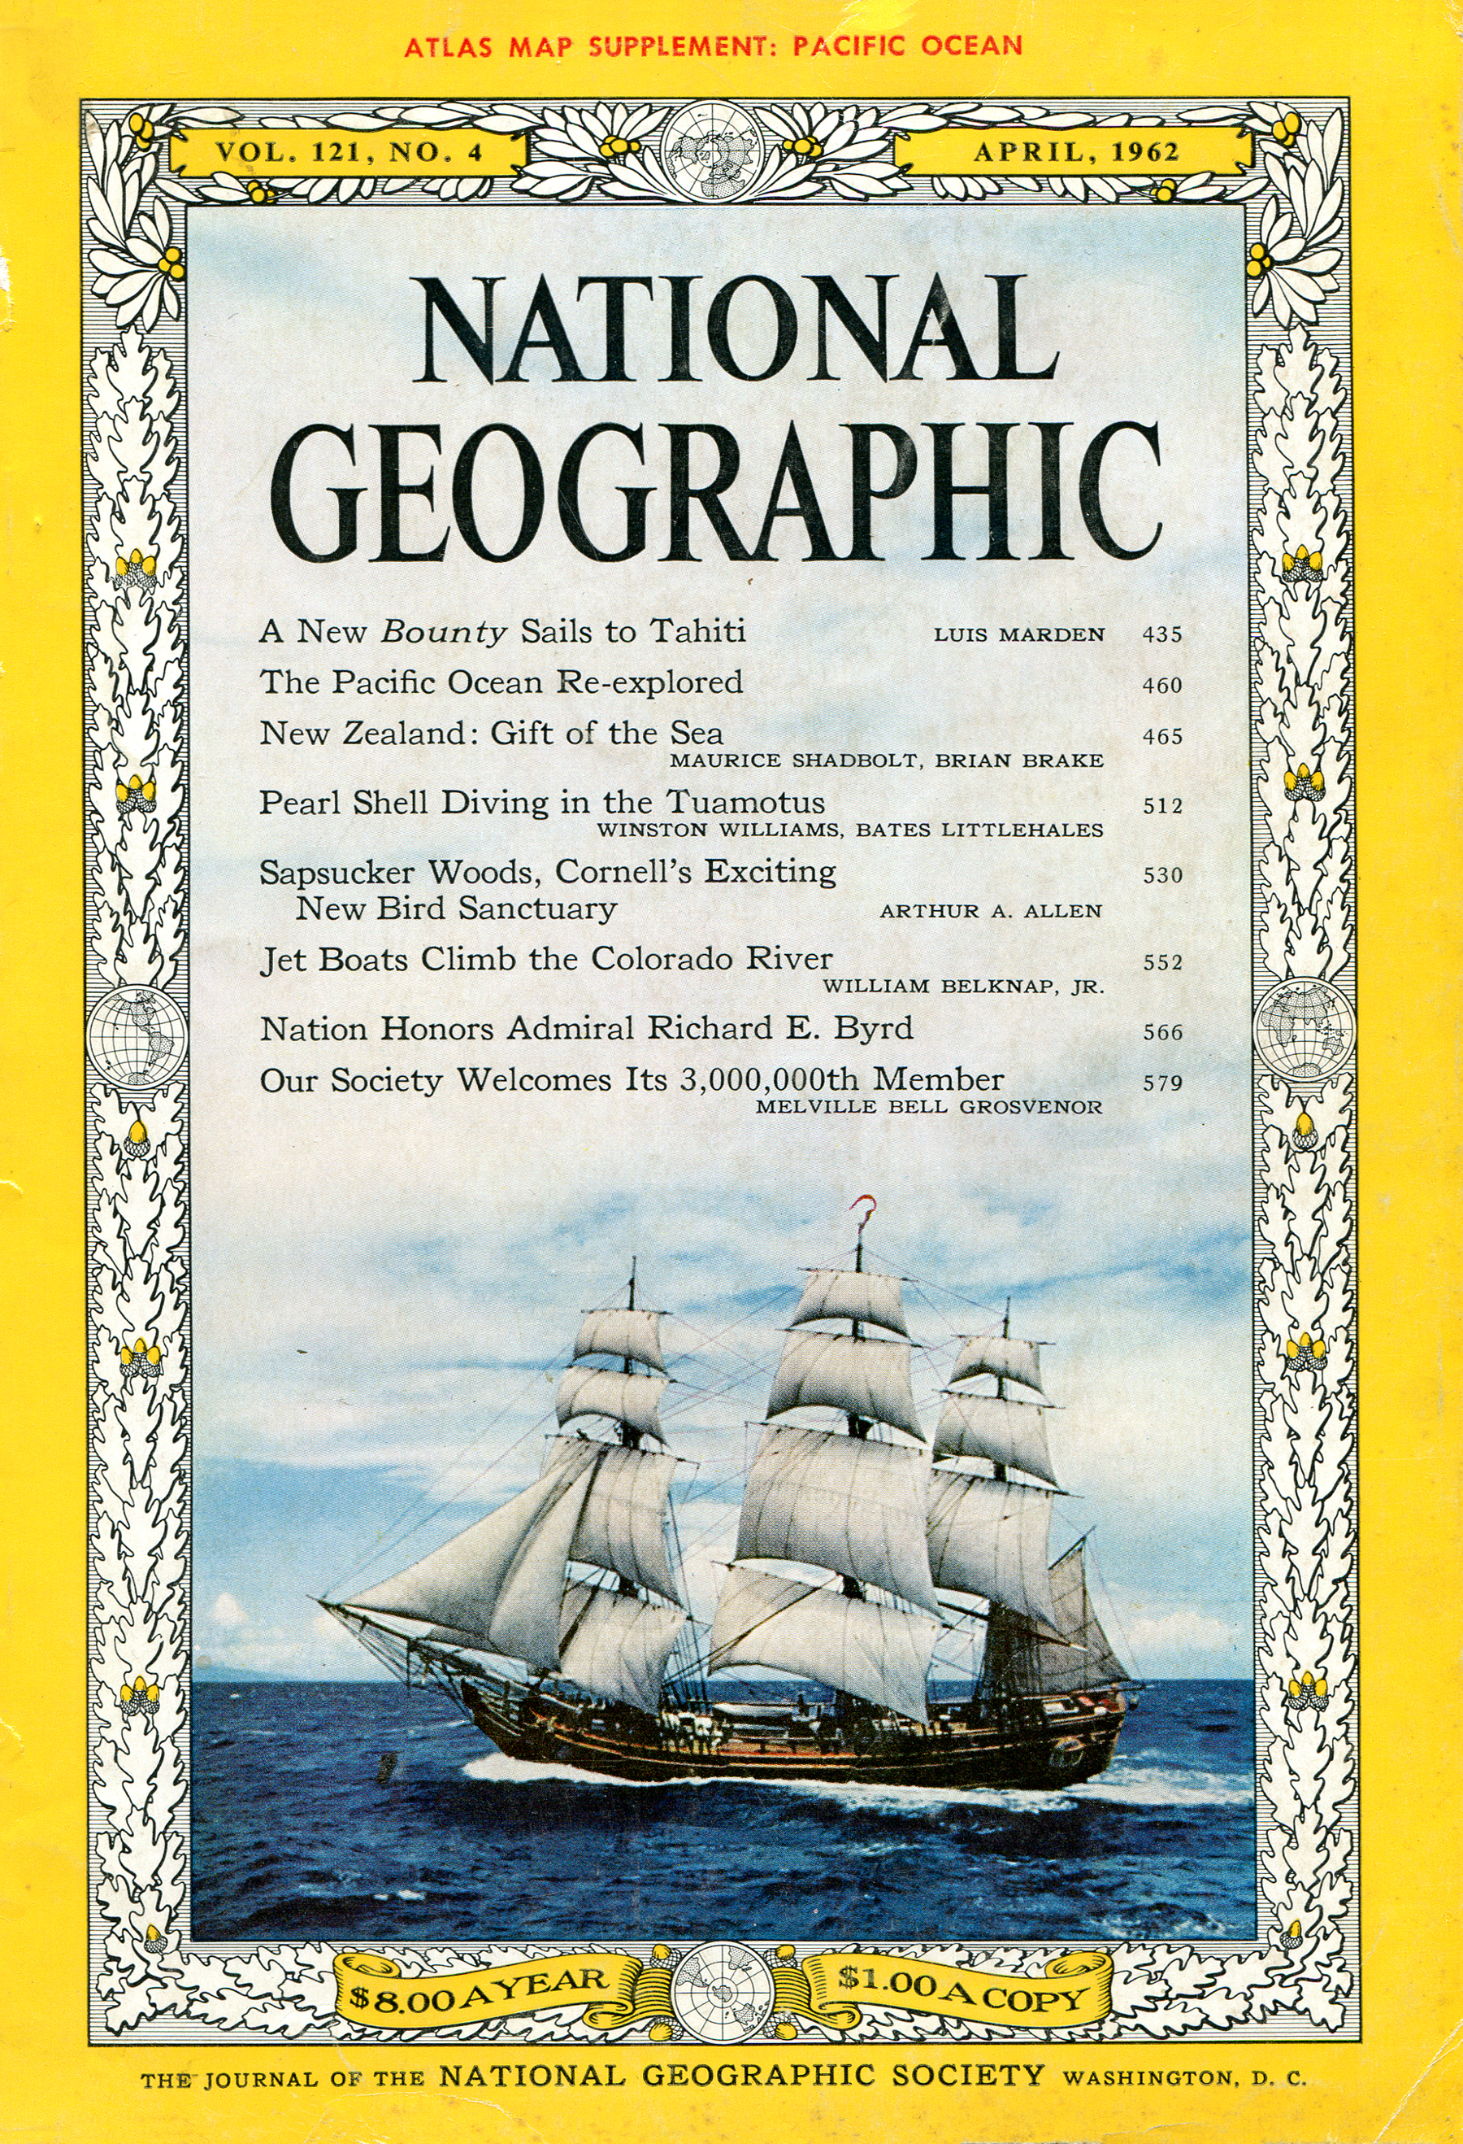
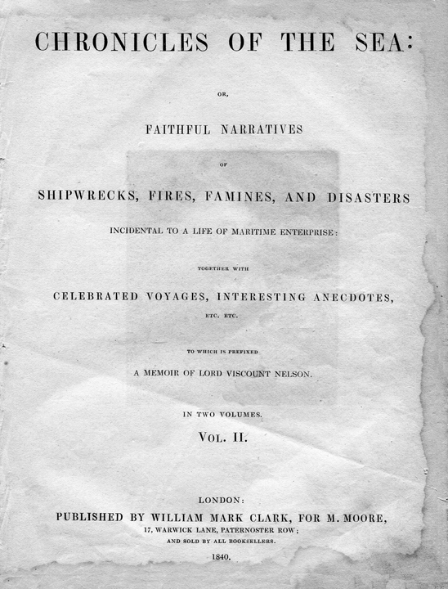
Notes:
From one-penny tabloids to the dignified pages of National Geographic, the popular press has been dipping into the deep well of the Bounty Saga since the early 1800s. This afternoon, let’s take a brief tour of “Mutiny in the Magazine Section.”

Slide 3
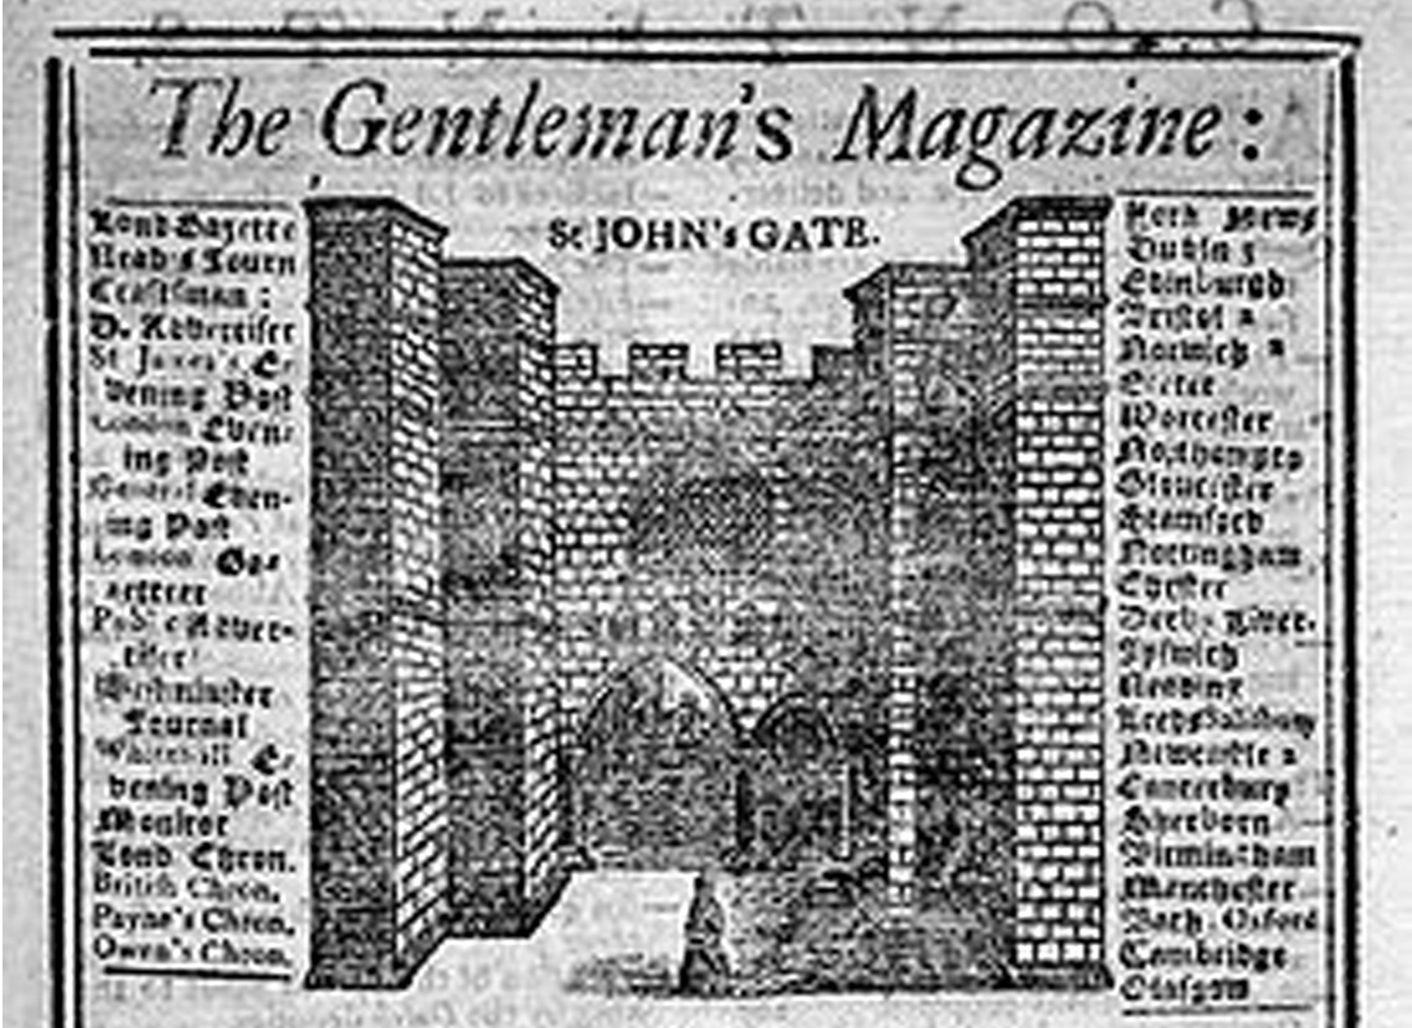
The Gentleman’s Magazine - May 1790
Notes:
News of the Bounty mutiny and William Bligh’s spectacular open boat voyage immediately sparked the interest of virtually everyone in England. In May 1790, barely one year after the mutiny, The Gentleman’s Magazine devoted a page to the events.

Slide 4
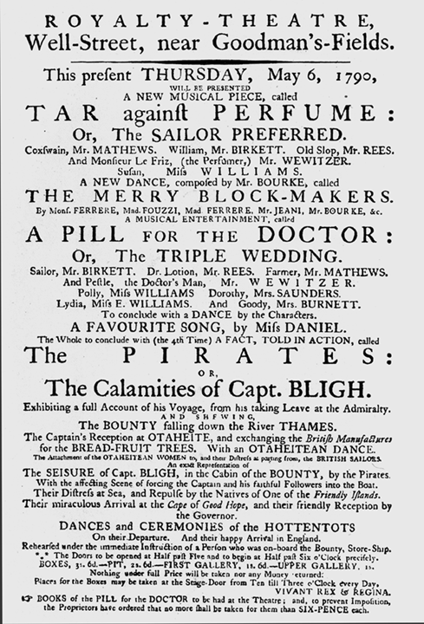
“The Pirates: Or, The Calamities of Capt. BLIGH”
Notes:
Almost overnight an entertainment called The Pirates: Or, The Calamities of Capt. Bligh, opened at the Royalty Theatre.

Slide 5
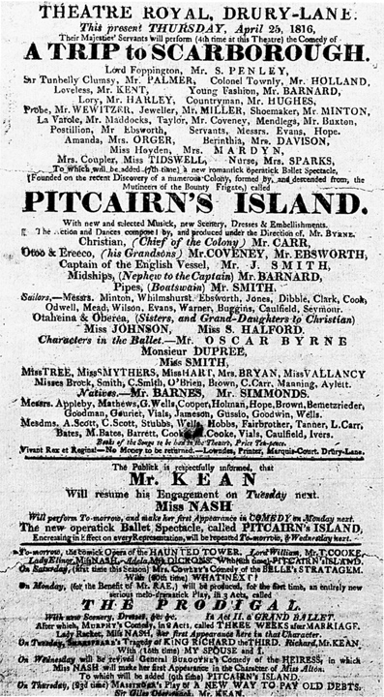
“A New Romantick Operatick Ballet Spectacle. . .”
Notes:
Years later, the discovery of the settlement on Pitcairn Island revived public interest in the Bounty, which led to additional stage adaptations such as A New Romantick Operatick Ballet Spectacle [Founded on the Recent Discovery of a Numerous Colony, Formed by, and Descended from, the Mutineers of the Bounty Frigate,] called Pitcairn’s Island.

Slide 6
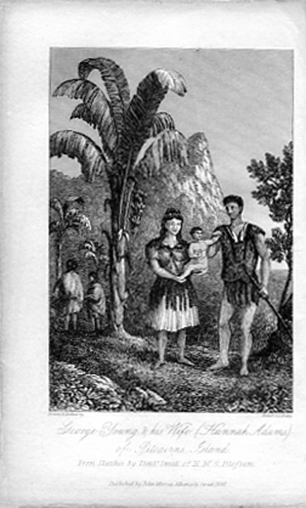
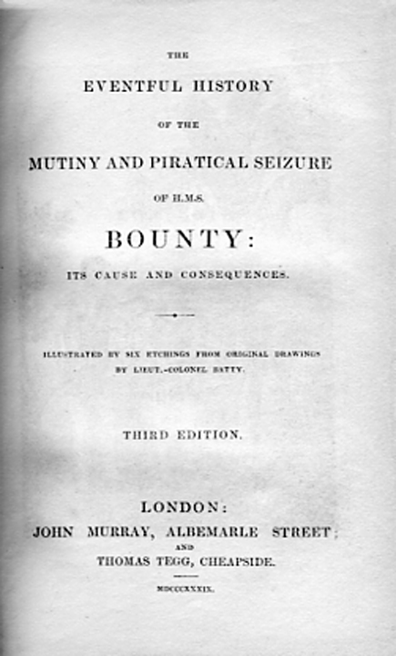
Notes:
Sir John Barrow renewed interest in the subject when he published The Eventful History of the Mutiny and Piratical Seizure of H.M.S. Bounty. Since then, articles about the Bounty and Pitcairn Island have become staples in the popular press.

Slide 7
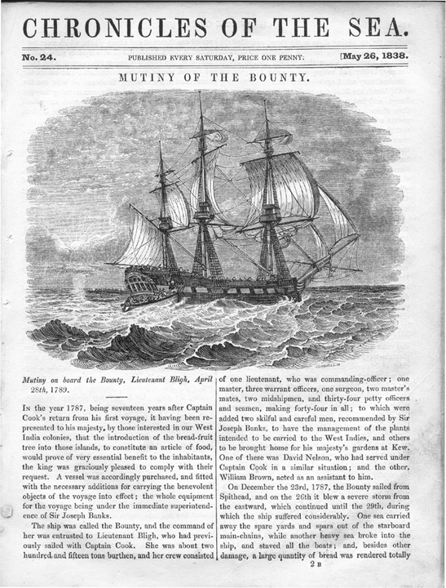
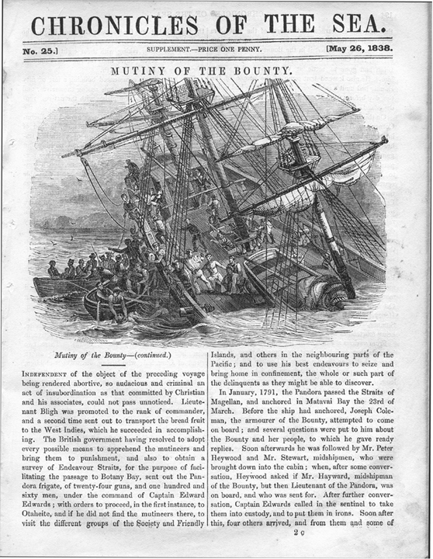
Chronicles of the Sea - 1838
Notes:
Here’s an early example: the one-penny Chronicles of the Sea, which published two issues about the mutiny. This article featured nicely detailed illustrations of Bounty and Pandora.

Slide 8
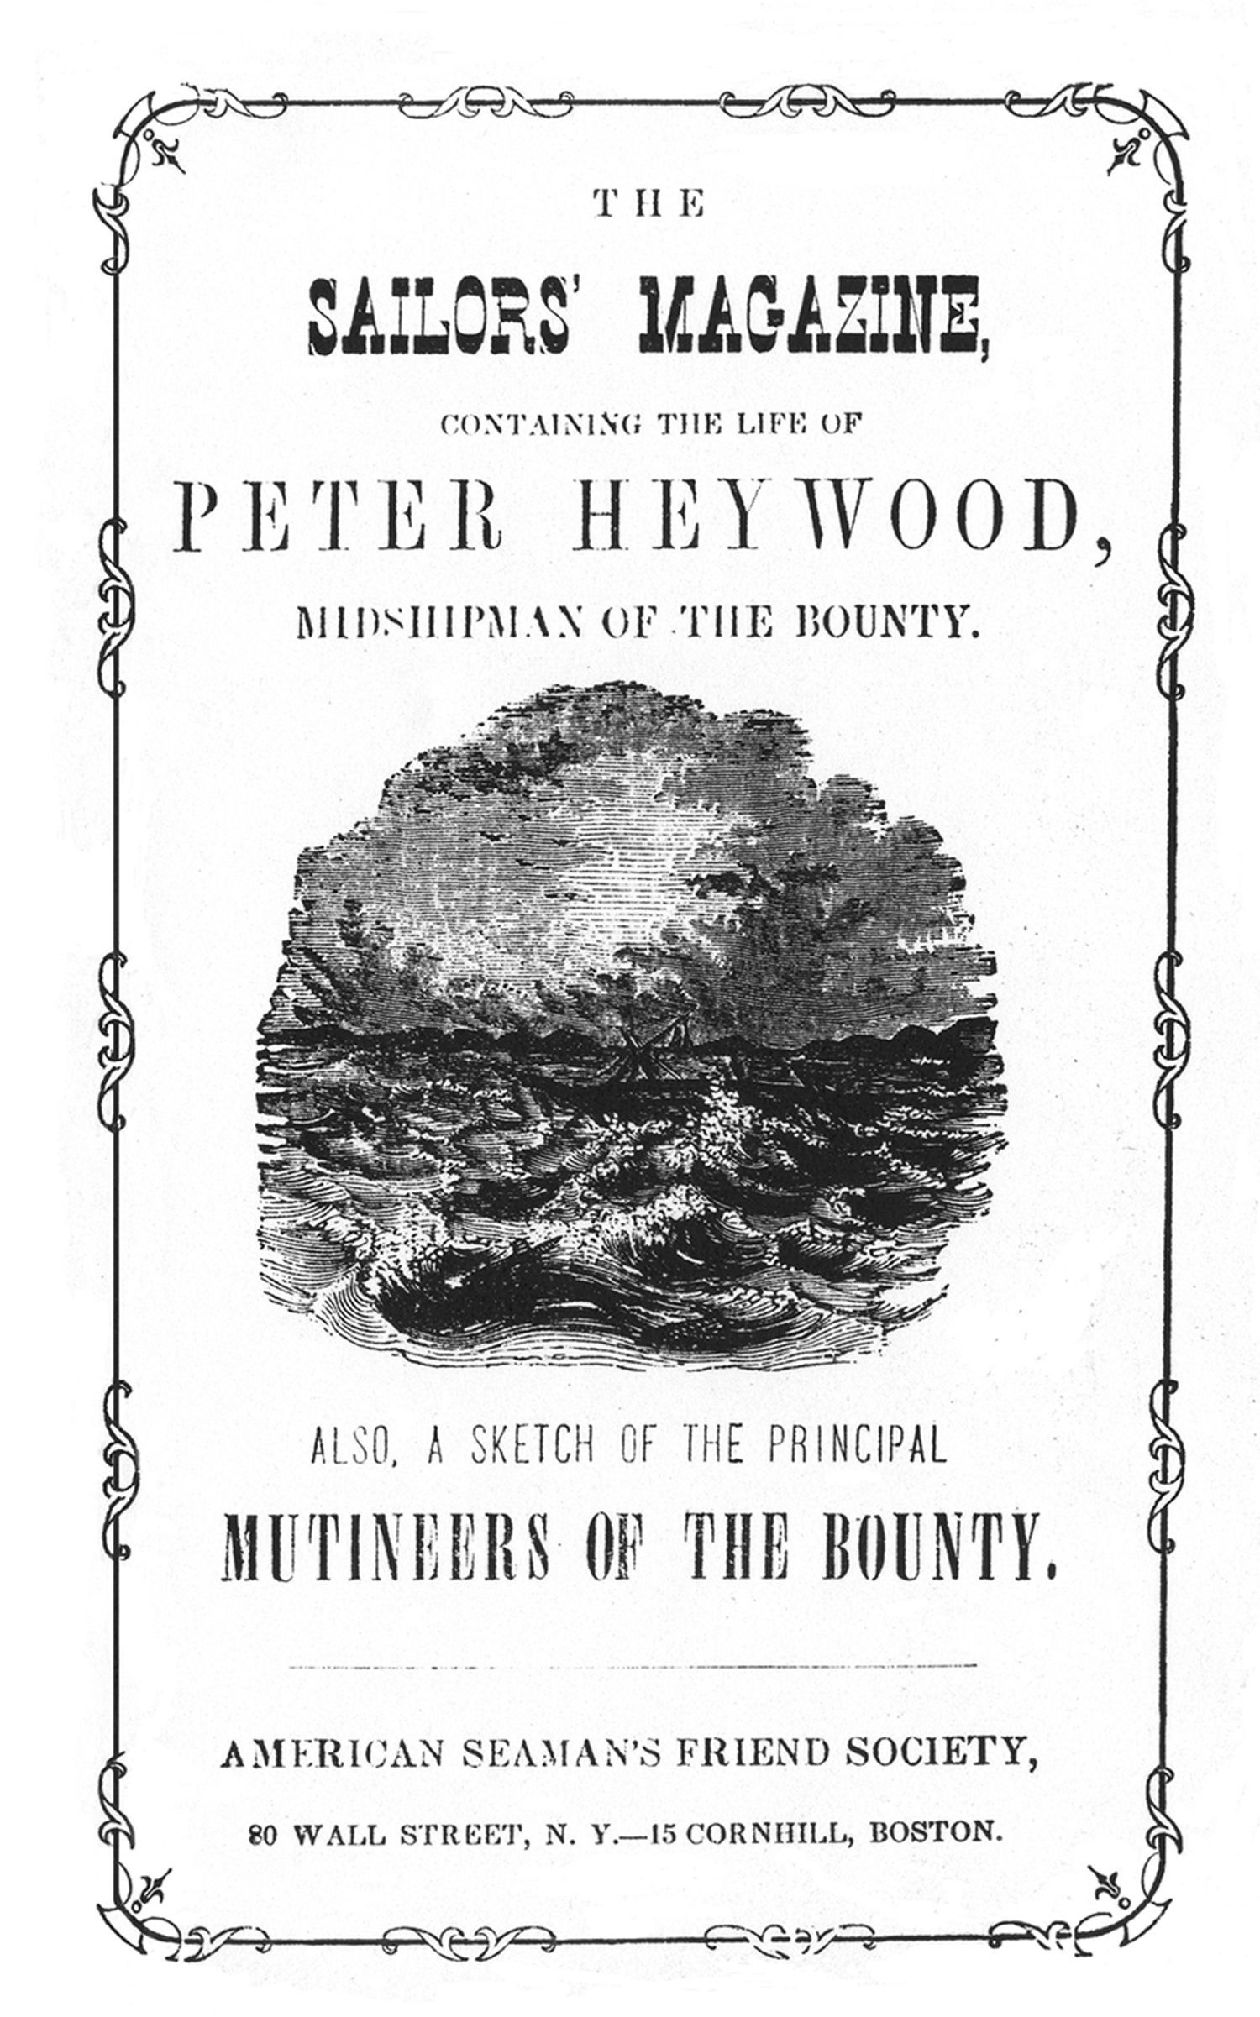
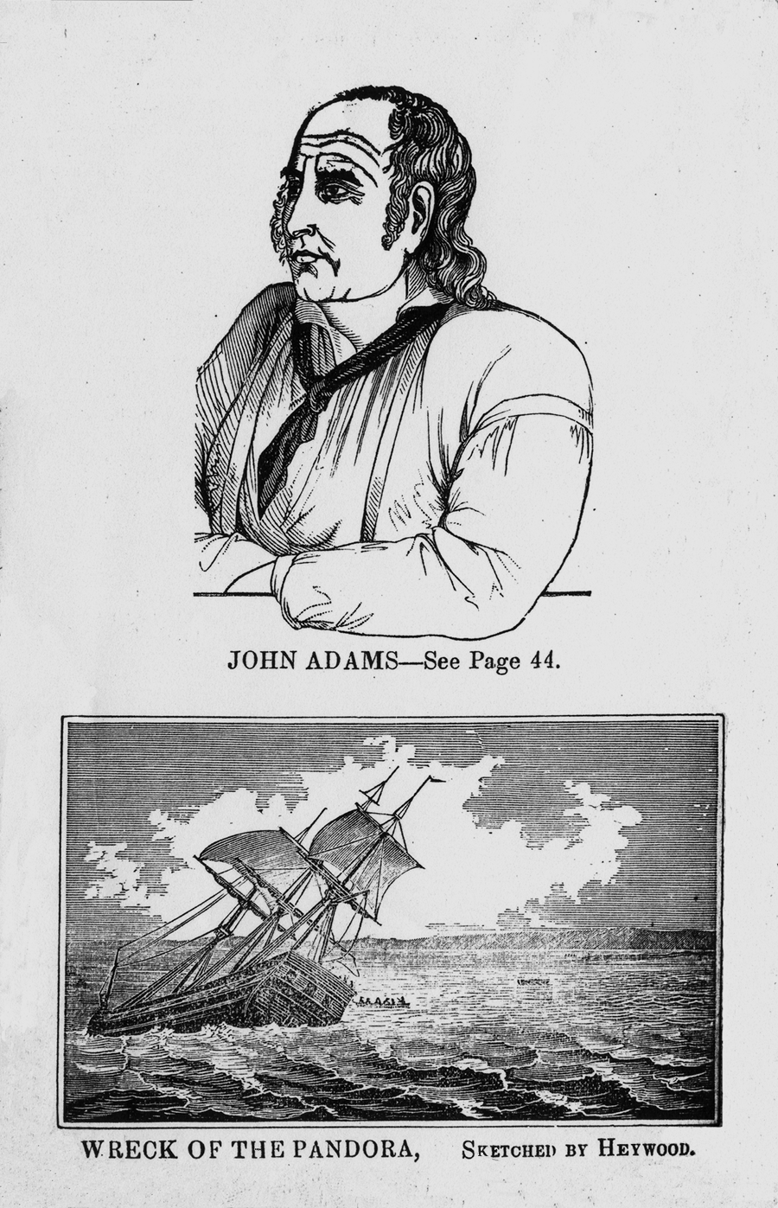
The Sailors’ Magazine - circa 1865
Notes:
In the 1860s, The Sailors’ Magazine, a publication of the Seaman’s Friend Society, published a 48-page biography of Bounty Midshipman Peter Heywood. While it does includes some accurate information, it is laced with quotes from the scriptures, and facts are frequently ignored or distorted to express the Society’s viewpoint and provide a moral lesson to the reader.

Slide 9
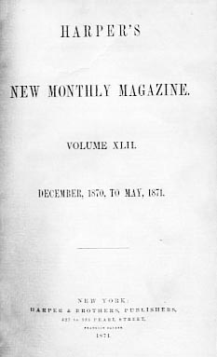
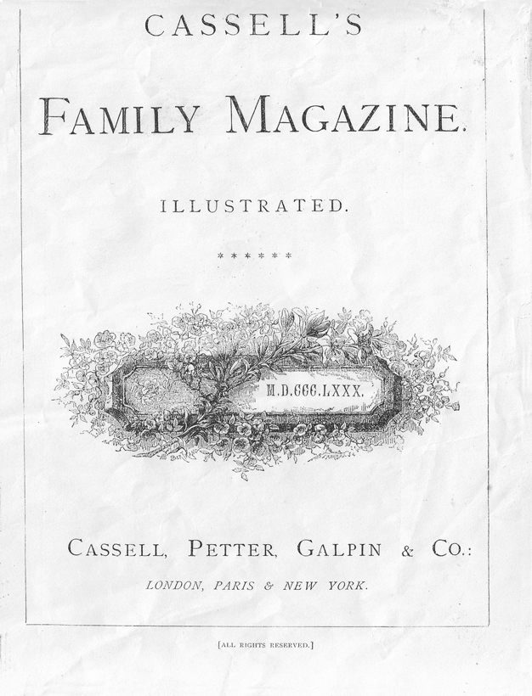
A Golden Age of Periodicals
Notes:
In fact, the 19th century was a “Golden Age” of popular periodicals, such as Cassell’s Family Magazine, Harper’s New Monthly Magazine, and dozens more. With its history of violence followed by religious redemption, the story of Pitcairn Island was a staple with readers of that era, and numerous retellings appeared in periodicals throughout the 19th century.

Slide 10
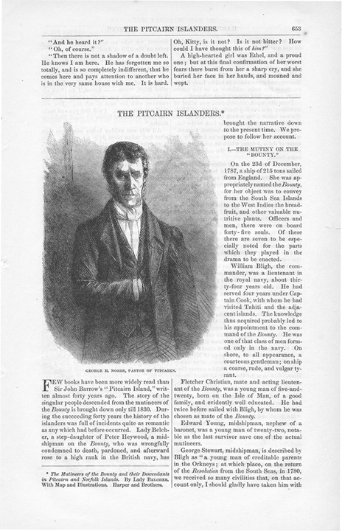
Harper’s New Monthly Magazine - 1871
Notes:
In 1871, Harper’s serialized parts of Lady Belcher’s book The Mutineers of the Bounty, opening with a portrait of George Nobbs.

Slide 11
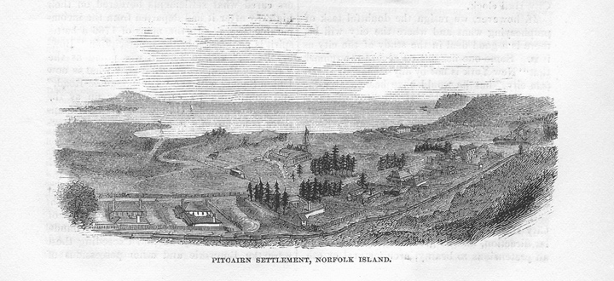
Harper’s New Monthly Magazine - 1871
Notes:
The article also included this engraving of the Pitcairn Settlement on Norfolk Island.

Slide 12
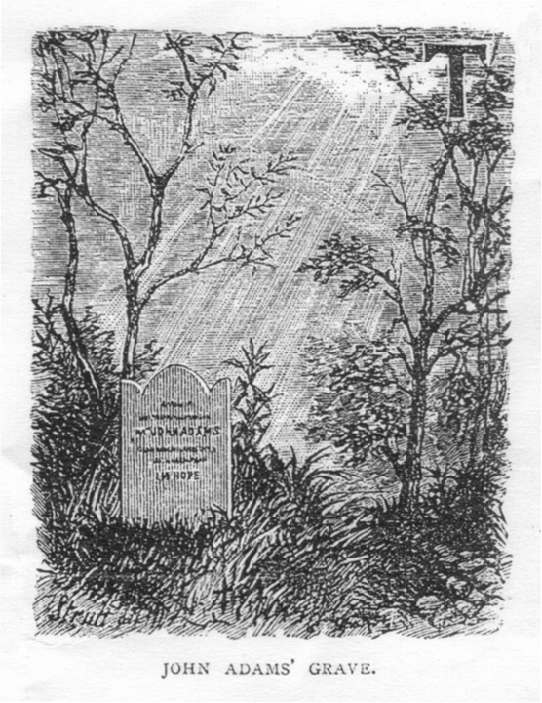
Cassell’s Family Magazine - 1880
Notes:
Cassell’s published “The Pitcairn Islanders, and the Mutiny of the Bounty,” which included an illustration of John Adams’s grave...

Slide 13
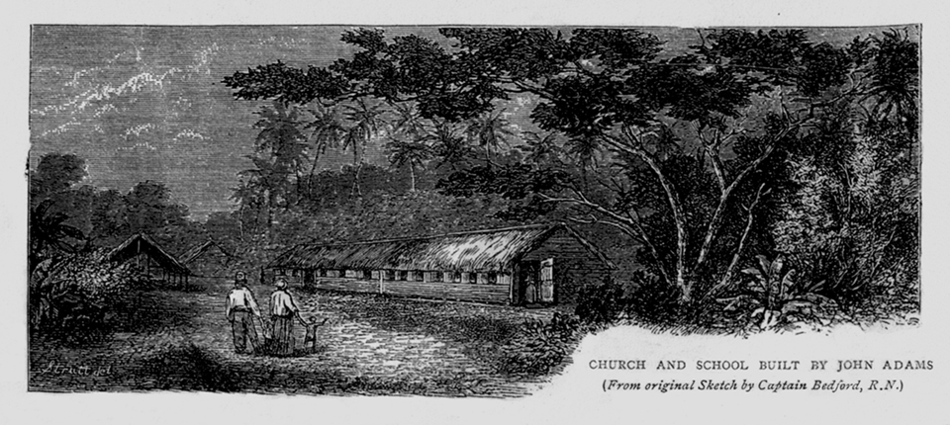
Cassell’s Family Magazine - 1880
Notes:
...and the church and school built by John Adams.

Slide 14
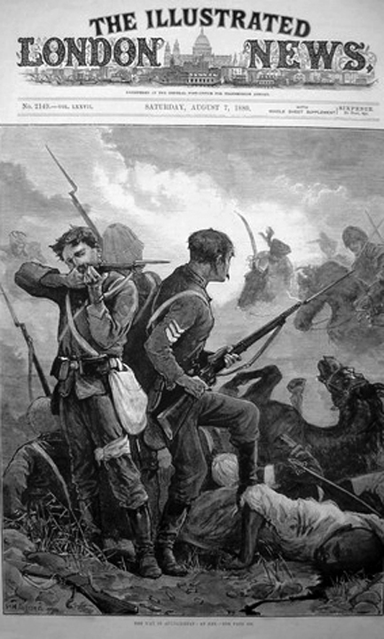
The Illustrated London News
Notes:
The Illustrated London News ran many Bounty Saga articles over its long life, such as…

Slide 15
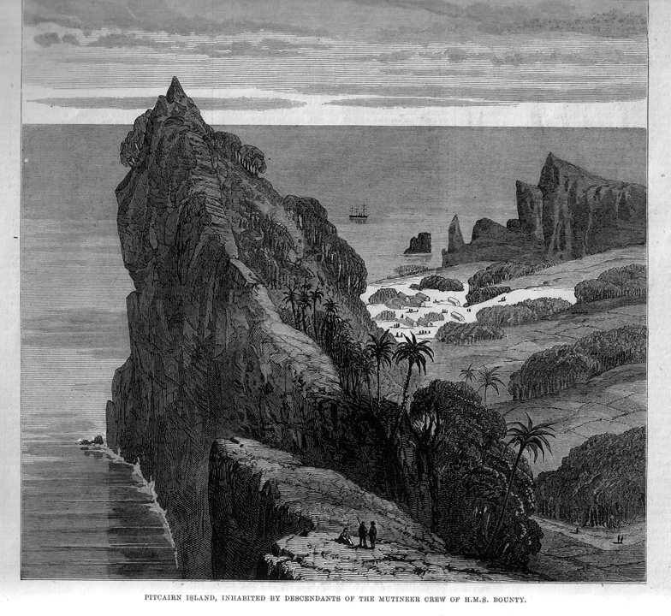
The Illustrated London News - 1879
Notes:
“The Pitcairn Islanders,” which included this aerial view of Ship Landing Point and Adamstown.

Slide 16
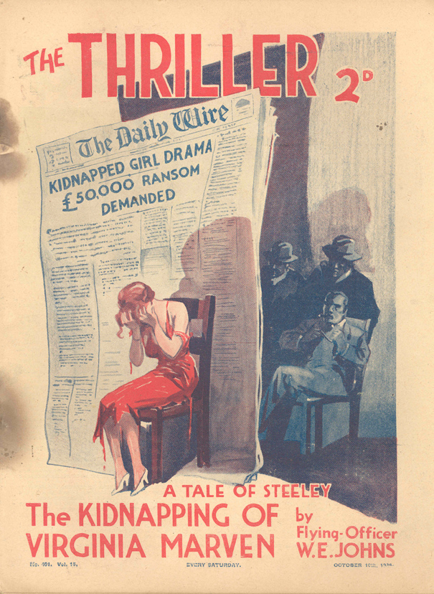
The Thriller - 1936
Notes:
Let’s move ahead now to the 20th century. A two-penny paper named The Thriller serialized Nordhoff and Hall’s Mutiny on the Bounty over six issues in 1936, declaring it to be “The finest true-life story every written.”

Slide 17
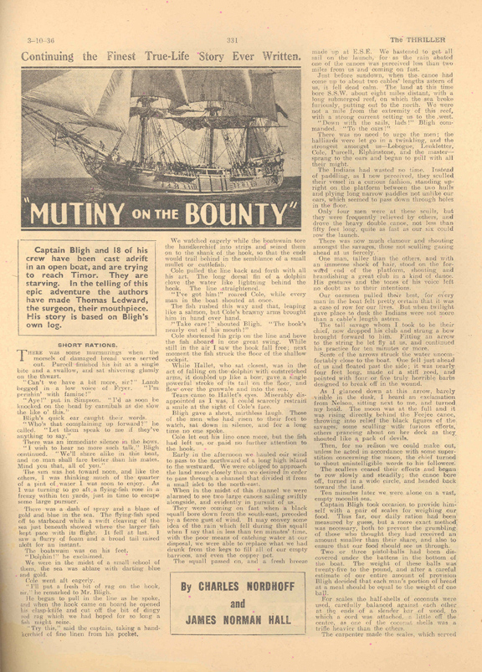
The Thriller - 1936
Notes:
That may be true, but the novel actually serialized was Men Against the Sea, with a still photo of the ship used in the movie. Obviously, The Thriller operated on a very tight budget.

Slide 18
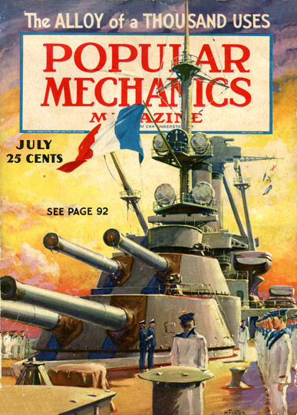
Popular Mechanics - 1936
Notes:
Who would have dreamed that Popular Mechanics would publish an article about the Bounty?

Slide 19
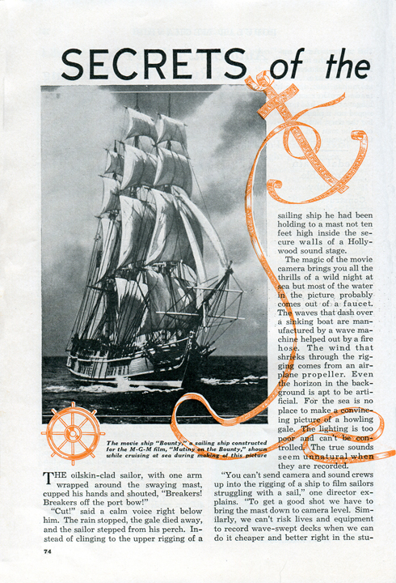
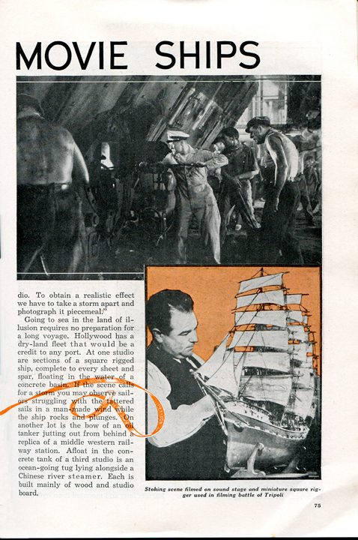
Popular Mechanics - 1936
Notes:
But that’s just what they did. “Secrets of the Movie Ships,” including the one used in the MGM Mutiny on the Bounty, appeared in the July 1936 issue.

Slide 20
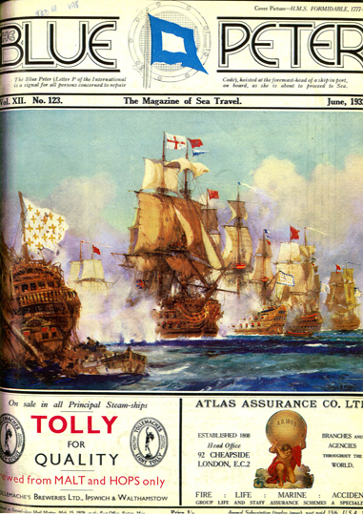
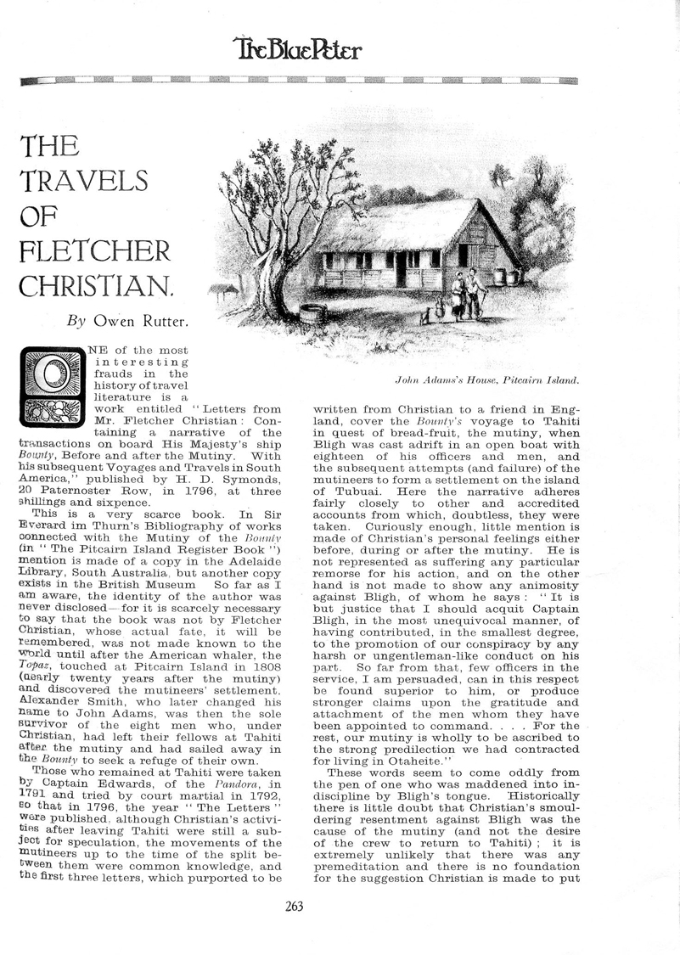
The Blue Peter - 1932
Notes:
In 1932, The Blue Peter magazine featured “The Travels of Fletcher Christian” by Bounty scholar Owen Rutter, based on Christian’s fictional correspondence, which Rutter called, “One of the most interesting frauds in the history of travel literature.”

Slide 21
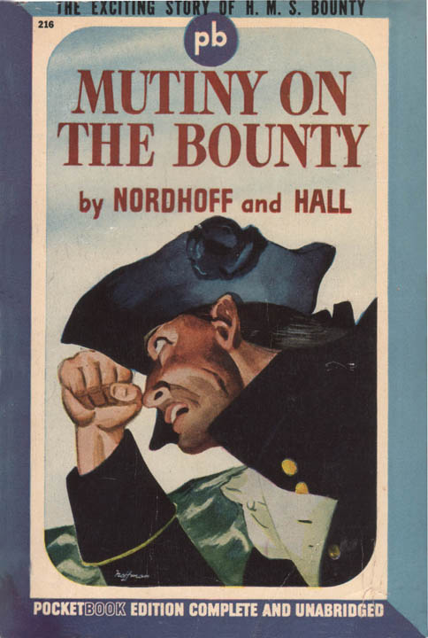
Notes:
Paperback books started to appear alongside magazines in the late 1930s. The first ones were issued by Pocket Books, which eventually secured the rights to reprint Nordhoff and Hall’s Bounty Trilogy novels.

Slide 22
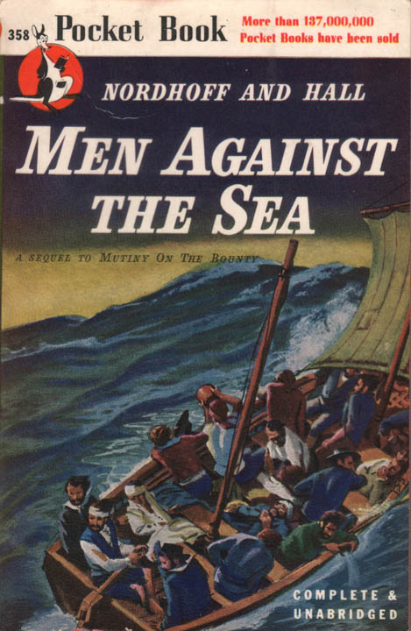
Notes:
The first paperback editions of these books appeared in the mid-1940s.

Slide 23
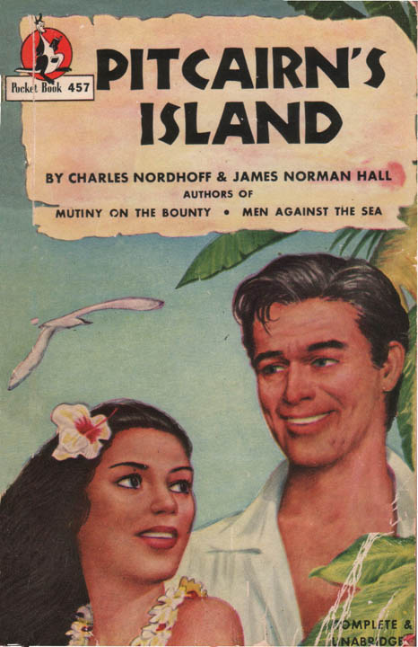
Notes:
The low price and colorful covers of these paperbacks gave millions of readers—many of whom had seen the MGM film Mutiny on the Bounty—the chance to discover the novels that inspired the film.

Slide 24
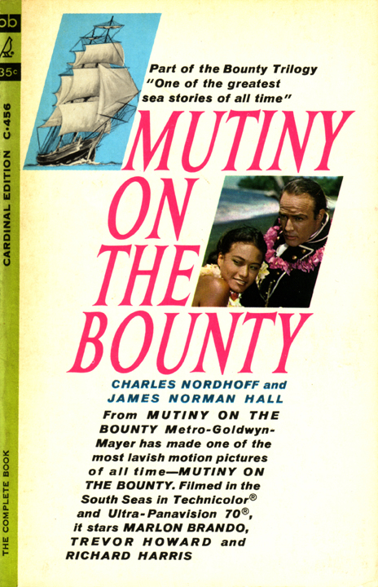
Notes:
One set paperback was tied in with the 1962 film version starring Marlon Brando. Two of the volumes include a photo of Brando with Tahitian actress Tarita, his future wife, who he met during the filming.

Slide 25
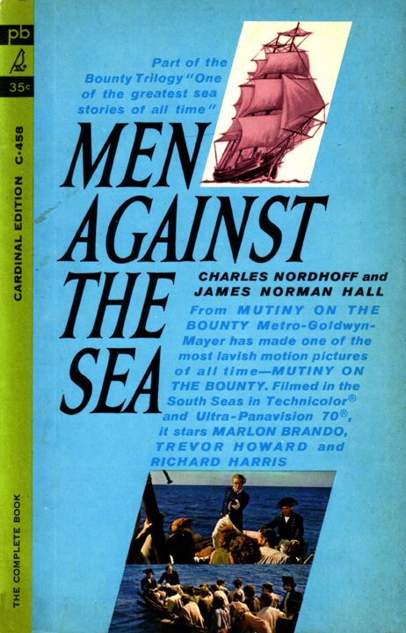
Notes:
Each volume featured full color stills from the movie.

Slide 26
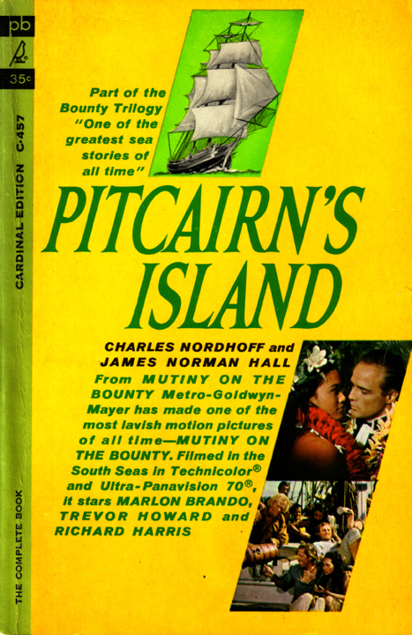

Slide 27
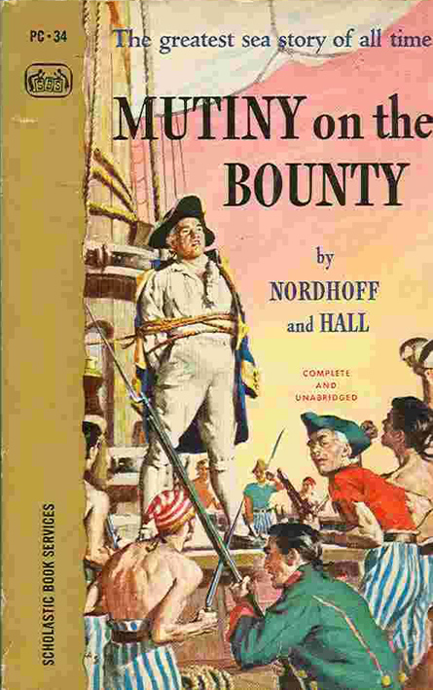
Notes:
Pocket Books also produced a “scholastic” edition of Mutiny on the Bounty for sale in in the classroom.

Slide 28
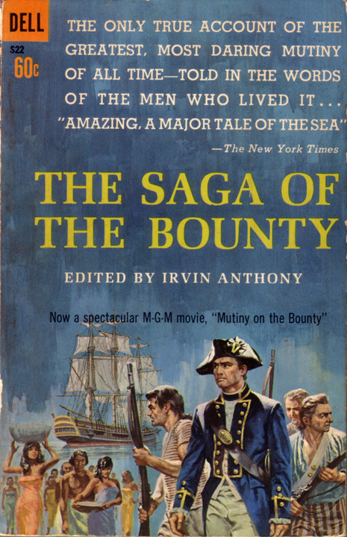
Notes:
Other paperback publishers, such as Dell and Berkeley, provided a great service by making more serious Bounty/Pitcairn scholarship available in inexpensive editions, including Irvin Anthony’s The Saga of the Bounty…

Slide 29
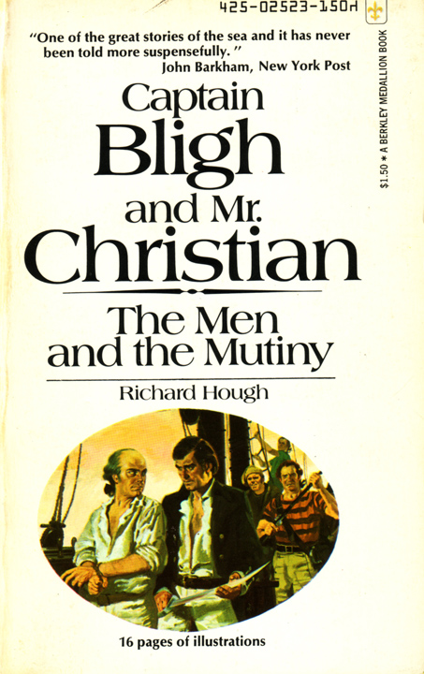
Notes:
…and Richard Hough’s Captain Bligh and Mr. Christian.

Slide 30
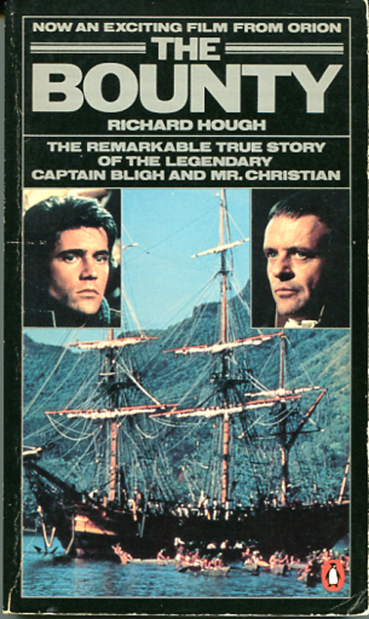
Notes:
Hough’s book was revised, retitled and reissued in 1984 as a tie-in to the Mel Gibson/Anthony Hopkins film version.

Slide 31
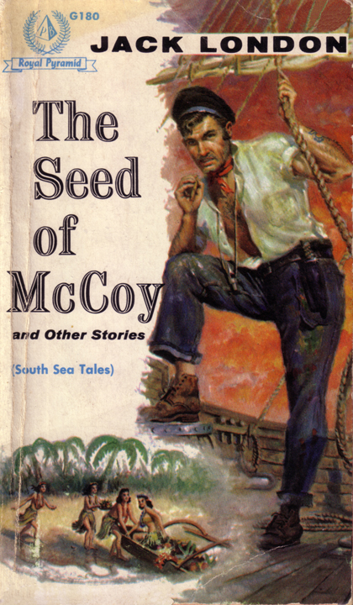
Notes:
A paperback edition of Jack London’s famous tale “The Seed of McCoy” published by Pyramid Books in 1956, featured an illustration very much in line with the men’s magazines of that era.

Slide 32
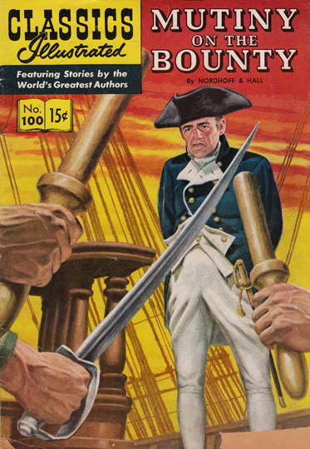
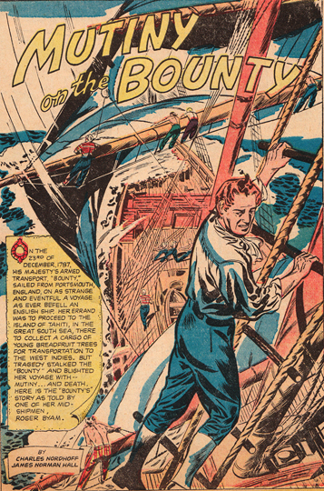
Classics Illustrated - Mutiny on the Bounty
Notes:
Along with the rise of paperbacks, a very special comic book began to appear on the newsstands. Classics Illustrated attracted millions of young readers. Its 100th issue, published in 1952, was Nordhoff and Hall’s Mutiny on the Bounty.

Slide 33
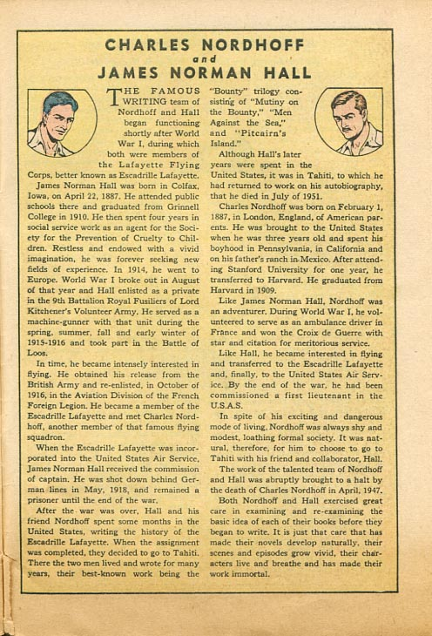
Classics Illustrated - Mutiny on the Bounty
Notes:
This issue even offered biographies of the two authors.

Slide 34
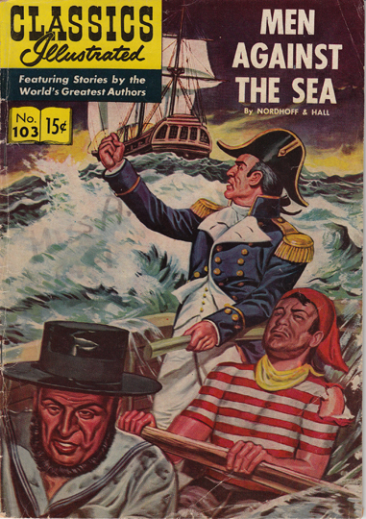
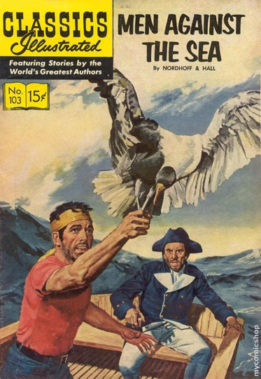
Classics Illustrated - Men Against the Sea
Notes:
Mutiny on the Bounty was quickly followed by Men Against the Sea, which featured, as you can see, some excellent examples of comic book art.

Slide 35
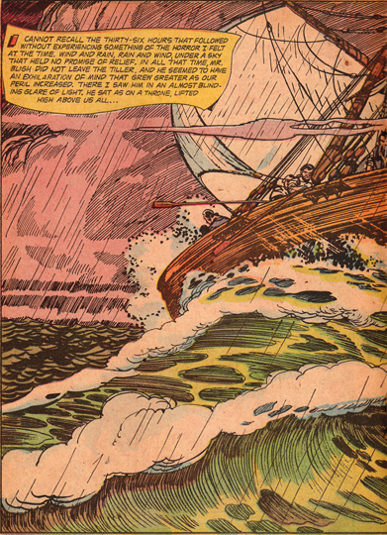
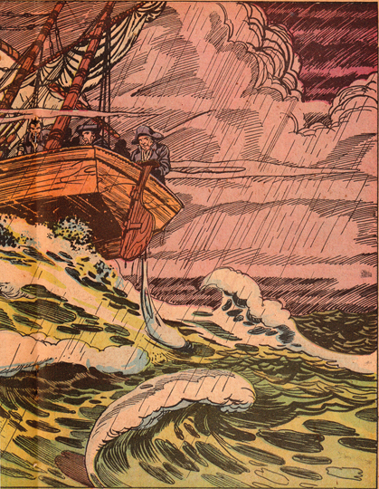
Classics Illustrated - Men Against the Sea
Notes:
I think this two-page spread is particularly impressive.

Slide 36
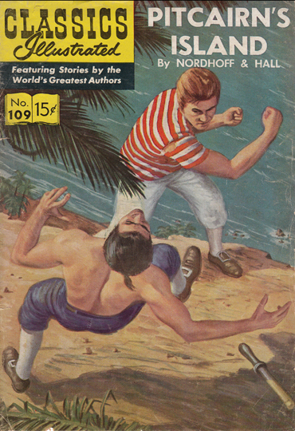
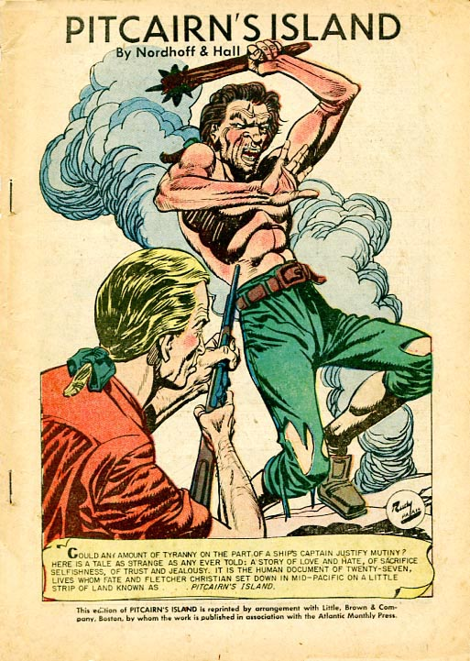
Classics Illustrated – Pitcairn’s Island
Notes:
Some of the images in Pitcairn’s Island were so violent that Classics Illustrated took it out of print for seven years.

Slide 37
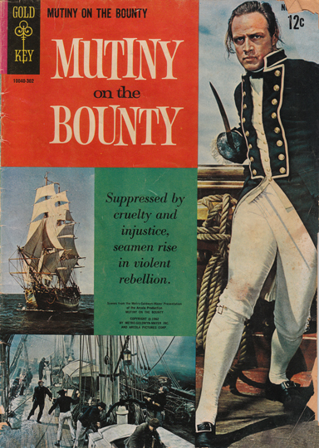
Gold Key Comics - Mutiny on the Bounty
Notes:
When the1962 film version on Mutiny on the Bounty was released, Gold Key Comics published a version withMarlon Brando striking a dashing pose on the cover.

Slide 38
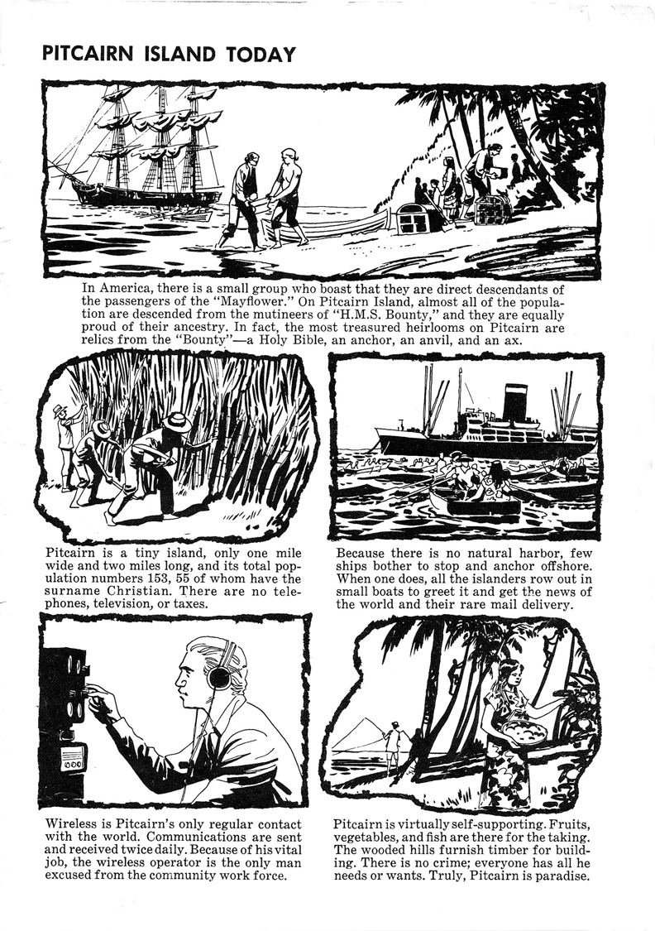
Gold Key Comics - Mutiny on the Bounty
Notes:
Like Classics Illustrated, Gold Key comics also included educational information for young readers.

Slide 39
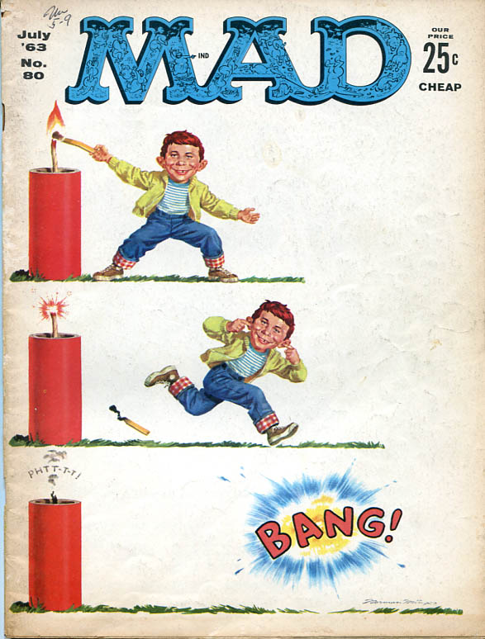
Mad Magazine - 1963
Notes:
Here’s a magazine that couldn’t resist making fun of Brando’s affected performance in Mutiny on the Bounty. Mad Magazine’s version was entitled…

Slide 40
Mad Magazine - 1963
Notes:
“Mutiny on the Bouncy,” portraying Brando as a foppish, indecisive mutineer.

Slide 41
“I really don’t think I’ll deliver my line today! I’m just not inspired! The sea isn’t exactly right—the wind is a little too strong in my hair—and the moon is one day past full! We’ll have to try again next month!”
Notes:
Mad’s writers had a lot of fun satirizing Brando’s temperamental behavior during the filming, which added to the movie’s monumental budget.

Slide 42
Man’s World - 1969
Notes:
Here’s another magazine from the 1960s. Man’s World is one of countless “Stag Magazines” that were targeted at male audiences at the time.

Slide 43
Man’s World - 1969
Notes:
Now, this magazine wasn’t exactly concerned with historical accuracy as this illustration reveals. “I Survived the Savage Mutiny on the Bounty,” was supposedly based on Peter Heywood’s “Secret Diary.” As you can see, native women—who look more like Americans than Tahitians—somehow managed to stow away on the ship and get involved in the mutiny. Is it any wonder that Peter Heywood decided to stay on the Bounty?

Slide 44
National Geographic - 1985
Notes:
More sophisticated publications often appeared on the magazine racks right alongside the men’s magazines. For decades, National Geographic has been publishing superb articles, photographs and illustrations about the Bounty, Pitcairn Island and Norfolk Island. Luis Marden’s excellent article in the October 1985 issue also includes some outstanding artwork.

Slide 45
National Geographic - 1985
Notes:
I think this painting of the Pandora at Tahiti is one of the best artistic renderings of that event. The centerpiece is George Stewart’s wife “Peggy” as she holds up their baby so Stewart can see him from Pandora’s Box. Some of the Tahitian women are cutting their scalps with shark’s teeth or sharp pieces of shell.

Slide 46
National Geographic - 1985
Notes:
This next painting, of the prisoners, escaping from “Pandora’s Box,” brilliantly captures the frantic action of that tragic event.

Slide 47
The Saturday Evening Post - 1933-34
Notes:
Let’s step back in time several decades, and look at some fine illustrations of Men Against the Sea and Pitcairn’s Island, serialized by the Saturday Evening Post in 1933 and 1934.

Slide 48
Notes:
Men Against the Sea appeared in four consecutive issues with illustrations by Anton Otto Fischer—“Artist Laureate” of the United States Coast Guard. Since we’re all familiar with this novel, I’m going to display each picture with its respective caption. I’ll provide the context.

Slide 49
Our boat buried her nose in each breaking wave. “Stand by to come about! he shouted, and then, “Hard alee!”
Notes:
After the mutiny, Bligh and the crew prepare to make a landing on the island of Tofua.

Slide 50
“We proceeded toward the beach, everyone in a kind of silent horror.”
Notes:
When Bligh realizes the hostility of the natives, they slowly retreat toward the beach in this unforgettable scene. Quartermaster John Norton was killed in the attack that followed.

Slide 51
“If you do not, you shall go ashore—With me, and with me alone.”
Notes:
In one of several confrontations with Bligh, Ship’s Carpenter William Purcell, who was wounded in the head during the attach at Tofua, insists on making landfall, disregarding the danger of hostile islanders.

Slide 52
Every man in the boat felt pretty certain that it was a case of row for our lives.
Notes:
As Bligh sails the launch through the Fiji Islands, the crew is pursued by islanders that may have cannibalistic intentions.

Slide 53
“Up with your weapon, you mutinous villain! I’ll soon prove whether you are a man or not!”
Notes:
Purcell again refuses to obey an order, declaring that he is as good a man as Bligh. Purcell, as you can see, backs down.

Slide 54
We changed our course not a moment too soon, when the waterspout passed astern of us, a sight of awe-inspiring majesty.
Notes:
In this scene, the crew is terrified as well as in awe of a sudden waterspout.

Slide 55
Notes:
Here’s a Saturday Evening Post ad alerting readers to the upcoming serialization of Pitcairn’s Island.

Slide 56
“Keep on,” ordered Christian. “Let us see what is beyond.”
Notes:
Master illustrator W.H.D. Koerner painted a series of stunning images to accompany this novel. Again, I’ll let you read the captions. Here, Christian persists in his search for somewhere to make a safe landing.

Slide 57
“Have you found any evidence that people have been here before us?”
Notes:
Christian questions Brown as the crew explore the uninhabited island.

Slide 58
“I never even thought of that,” Brown replied.

Slide 59
Hutia glanced after the retreating figures.
Notes:
Hutia, an attractive 19 year-old, spies on Christian and Young passing through an island glade.

Slide 60
Young took Christian’s arm and pointed out to where the blackened hull of the ship had lain wedged among the rocks.
Notes:
During a terrific gale, Christian and Young discover that the storm has hidden what was left of the Bounty after it was burned.

Slide 61
Koerner’s original painting.
Notes:
Here’s Koerner’s original painting. It’s really a shame that these were not printed in color.

Slide 62
All day long the yams came in and were stowed aloft, without a halt for. . .
Notes:
Here are Pitcairn’s new residents toiling to bring in yams for planting in the fertile fields and for the day’s feast.

Slide 63
…dinner or a rest at noon. At sunset, the pafatas were bending under their loads.

Slide 64
Stopping at Quintal’s house to give Sarah a cut of albacore, Te Moa found the women alone.
Notes:
Te Moa provides Sara a piece of a large albacore that Tetahiti has caught. Tetahiti has just told Te Moa how furious he is at the white man’s treatment.

Slide 65
Nihau and Te Moa grasped his arms, lifting him, and carried him along, with his legs dragging on the ground.
Notes:
The Tahitian men prepare to murder Isaac Martin.

Slide 66
“I must find Christian, if he is alive. Now go, all, and search for Young.”
Notes:
After the murders begin, a rather brawny looking Alexander Smith runs to see if Christian and Young have survived.

Slide 67
Koerner’s original painting.
Notes:
Here is Koerner’s original painting of that scene.

Slide 68
Peering down through a tangle of thorny pandanus, Minarii gave a sudden low exclamation.
Notes:
Minarri spies two of the Bounty’s crew on the rocks below.

Slide 69
Koerner’s original painting.
Notes:
Koerner’s original painting.

Slide 70
We didn’t catch site of Quintal till we’d reached the valley.
Notes:
Quintal is astonished that the women have constructed a fort for protection.

Slide 71
Prudence, who was as good a shot as any man, stood behind with the musket resting on Moetua’s shoulder. They’d not spent twenty seconds in getting ready.
Notes:
While the children of Pitcairn look on, Prudence and Moetua attempt to shoot Quintal, who has descended into savagery.

Slide 72
They came: All the womenfolk, some carrying children, or leading ‘em, some with baskets and bundles.
Notes:
Following the deaths of Quintal and McCoy, Smith and Young are welcomed back into the new society that the women are building.

Slide 73
“The Women of Pitcairn”—not used in the serialization.
Notes:
Here’s a lovely painting that was not used in the serialization.

Slide 74
Smithsonian Magazine - 1988
Notes:
Let’s turn now to a more contemporary array of periodicals. In 1988, Smithsonian Magazine posed the evergreen question, “What Happened to Mr. Christian of H.M.S. Bounty?

Slide 75
British Heritage - 2003
Notes:
No, that’s isn’t a 90 year-old Fletcher Christian on the cover of British Heritage magazine, it’s Christopher Lee in The Lord of the Rings.

Slide 76
British Heritage - 2003
Notes:
But this issue does include an excellent article by the late Sven Wahlroos, who makes a convincing case that “Neither Bligh nor Christian caused the mutiny.”

Slide 77
British Heritage - 1989
Notes:
An earlier issue of British Heritage published an article speculating that Bligh and Christian may have had a homosexual relationship. This provoked a flurry of letters denouncing the theory in the following issue.

Slide 78
Naval History - Summer 1991
Notes:
Specialist magazines like Naval History and Sea History occasionally publish Bounty-related articles, including these issues from 1991 and 2007.

Slide 79
Sea History - Winter 2007-8

Slide 80
Yankee Magazine – 1998
Notes:
In 1998, Yankee Magazine, which has close ties to the venerable Old Farmer’s Almanac, published this article about the visit of the ship Cyrus to Pitcairn in 1839 and its link with the famous “Bounty Bibles.”

Slide 81
The New Yorker
Notes:
As we saw in Mad Magazine, humor is sometimes employed in the Bounty Saga articles. Since 1925, The New Yorker has entertained readers with its clever cartoons. Here’s one of my favorites, which suggests that Bligh’s bad grammar provoked the mutiny.

Slide 82
The crew can no longer tolerate Captain Bligh’s ruthless splitting of infinitives.
Notes:
“The crew can no longer tolerate Captain Bligh’s ruthless splitting of infinitives.”

Slide 83
The New Yorker - August 4, 2003
Notes:
In an August 2003 issue, The New Yorker got a little more serious and offered readers an excerpt from The Bounty, by Caroline Alexander. “Wreck of the Pandora: The Fate of the Men Sent to Hunt Down the Bounty Mutineers.” This article was issued with some evocative illustrations.

Slide 84
William Bligh
Peter Heywood
The New Yorker - August 4, 2003
Notes:
Here are the artist’s renderings of Bligh and Heywood. Note that Bligh has a rather stoic expression, while Heywood is given a rather sinister look, which matches Alexander’s interpretation of the mutiny and its aftermath.

Slide 85
The Atlantic Monthly - 2003
Notes:
My goodness, I believe we’ve gone back to the 2004 Presidential elections! The December 2003 issue of The Atlantic published “Captain Bligh’s Secret Logbook,” an amusing response to Caroline Alexander, whose main objective was to rehabilitate William Bligh’s reputation.

Slide 86
The Atlantic Monthly - December 2003
Notes:
The article satirizes Alexander’s theory by depicting Bligh as a weak, fussy commander. Let’s close with some excerpts from this piece. As the day of mutiny approaches, Bligh makes the following entries into his log:

Slide 87
April 26, 1789.
Awoke at 6 bells to a Commotion on deck. Found the men inebriated on taro-root beer and pelting each other with our precious Bread-fruits.

Slide 88
April 27, 1789.
Feeling confident that Order and good Naval discipline has been restored. The men go about their business, playing Bezique and Ten-o-Whiskers, napping and smoking and fishing and holding Spitting contests.

Slide 89
April 28, 1789. Wanting to reward this good Behaviour, at 7 bells I announced that we would have a nice refreshing swim before our noon-meal of Dolphin and Sharke ceviche in a lyme-cilantroe Reduction with julienned mangoes and mashed wasabi taro. (My own recipe.)

Slide 90
June 12, 1789. I do earnestly hope Christian delivered my Bread-fruit safely to the West Indies.
Notes:
Two months after the mutiny, Bligh is still an optimist.

Slide 91
Notes:
I think this presentation demonstrates that the Bounty Saga is destined to live on—not only in scholarly books and journals—but also in the magazine section of your local Walgreen’s or Barnes and Noble. You might see me there someday, looking for a magazine that just might have a new article about the Bounty or Pitcairn Island.
I hope you’ve enjoyed this tour of the Bounty Saga in the wonderful world of periodicals.
Thank you!

